Slide 1
Equilibrium Analysis in Concurrent Force Systems
Dr. Jacob Moore
Associate Professor of Engineering
Penn State Mont Alto

Slide 2
Equilibrium Analysis
In equilibrium analysis, we are examining a body that is in equilibrium, using the forces and geometry we know, to solve for unknown forces or other unknown values.
45º
30º
F₂ = ?
F₃ = ?
Y
X
F₁ = 600 lbs

Slide 3
Equilibrium Analysis
To determine these unknown forces, we use the process of equilibrium analysis, which consists of the following steps:
Draw a free body diagram of the body in the problem, showing all known and unknown forces.
Use the free body diagrams to write out the equilibrium equations
Solve the equilibrium equation for the unknowns.

Slide 4
Creating a Free Body Diagrams
Draw a picture of the body being analyzed separate from all the background objects.
Draw in any forces acting on the body.
Normal forces at any point of contact
Gravitational forces
Friction forces on rough surfaces
Tension in any cables or wire.
etc.
Add any angles for the force vectors and any key dimensions

Slide 5






Creating a Free Body Diagrams
Problem Diagram
Free Body Diagram
$$F_{N1}$$
$$F_{m}$$
1 m
1 m
$$F_{g}$$
2 m
65º
$$F_{F}$$
$$F_{N2}$$

Slide 6
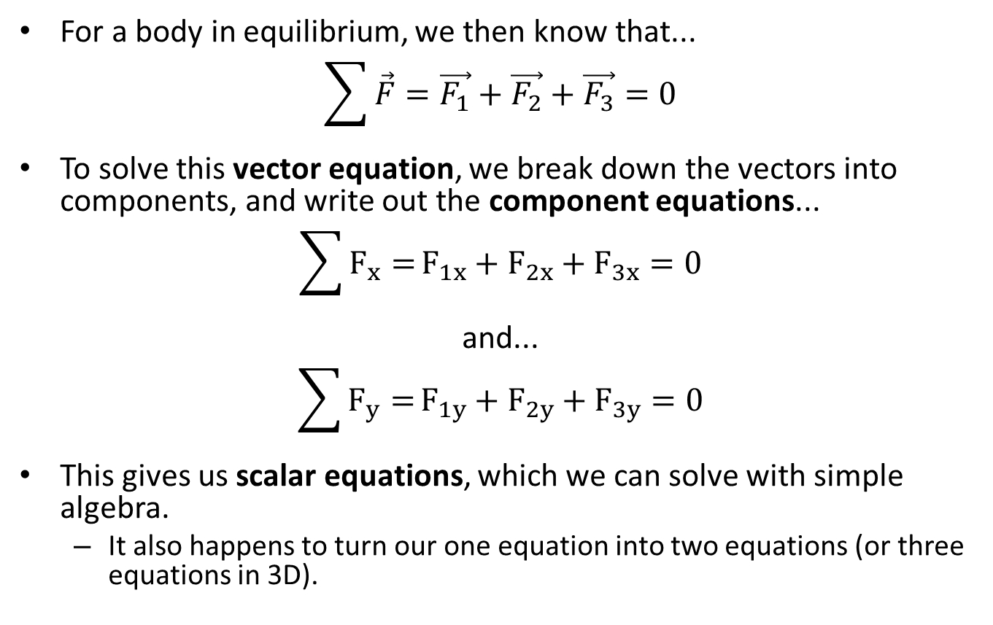
Equilibrium Equations
For a body in equilibrium, we then know that...
$$\sum{\vec{F}}=\vec{F_{1}}+\vec{F_{2}}+\vec{F_{3}}=0$$
To solve this vector equation, we break down the vectors into components, and write out the component equations...
$$\sum{F_{x}=}F_{1x}+F_{2x}+F_{3x}=0$$
and...
$$\sum{F_{y}=}F_{1y}+F_{2y}+F_{3y}=0$$
This gives us scalar equations, which we can solve with simple algebra.
It also happens to turn our one equation into two equations (or three equations in 3D).
x and y components of the vectors

Slide 7
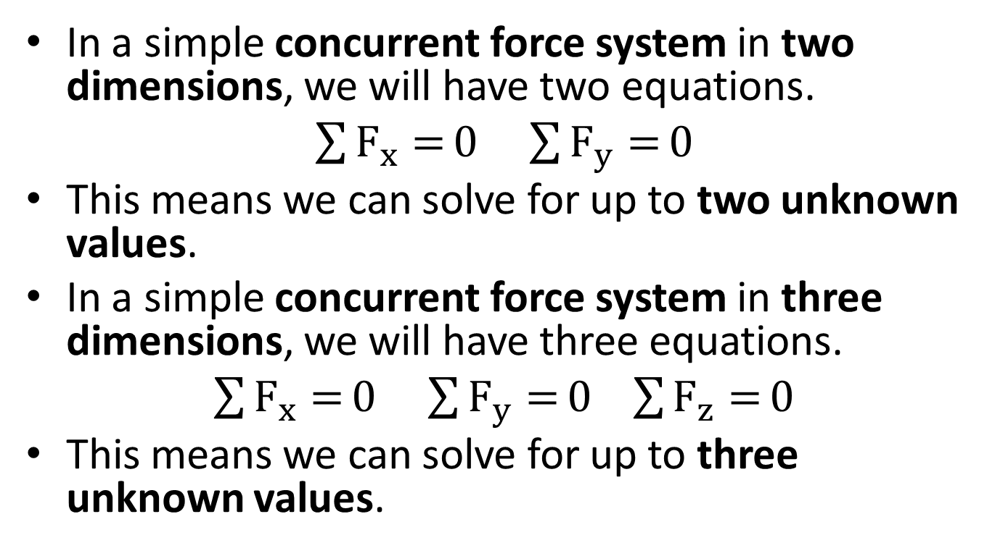
Solving the Equilibrium Equations
In a simple concurrent force system in two dimensions, we will have two equations.
$\sum{F_{x}=}0$ $\sum{F_{y}=}0$
This means we can solve for up to two unknown values.
In a simple concurrent force system in three dimensions, we will have three equations.
$\sum{F_{x}=}0$ $\sum{F_{y}=}0$ $\sum{F_{z}=}0$
This means we can solve for up to three unknown values.

Slide 8
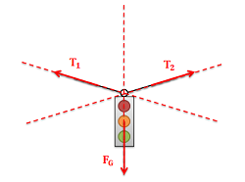
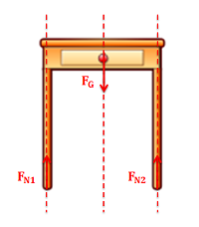
Moments and Concurrent Force Systems
concurrent
For now we are only working with concurrent force systems, and we are only working with force equilibrium equations.
When we work with non-concurrent force systems, we will need to additionally need to sum the moments to be equal to zero.
This will make problems more complex, but also give us more equations to solve for more unknowns.
non-concurrent

Slide 9
Equilibrium Analysis (Review)
To determine these unknown forces, we use the process of equilibrium analysis, which consists of the following steps:
Draw a free body diagram of the body in the problem, showing all known and unknown forces.
Use the free body diagrams to write out the equilibrium equations
Solve the equilibrium equation for the unknowns.

Slide 10
Thanks for Watching
See other engineering mechanics videos and access the full tool at…

Slide 11
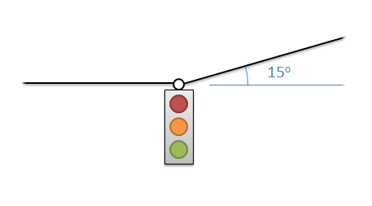
Concurrent Equilibrium Analysis Worked Example
The 6 kg traffic light shown below is supported by two cables. Find the tension force in the two cables.
Y
X

Slide 12
Concurrent Equilibrium Analysis Worked Example
A 600 lb barrel is sitting in a groove as shown below. Determine normal forces acting on the barrel at points A and B.
600 lbs
A
B
Y
45º
30º
X

Slide 13
Concurrent Equilibrium Analysis Worked Example
A cable supports a large mass resting along an angled surface. Determine the tension in the cable and the normal force acting on the mass.
15º
400 kg
45º

Slide 14
Concurrent Equilibrium Analysis Worked Example
Three cables come together at the angles indicated. The tension in cable is 50 lbs. Determine the tension in the other two cables.
T_{B} = ?
T_{A} = 50 lbs
45º
15º
65º
T_{C} = ?

Slide 15
Concurrent Equilibrium Analysis Worked Example
Two barrels are being carried on a handcart as shown below. Determine all forces acting on the bottom barrel.
A
150 lbs
B
200 lbs
30º

Slide 16
Concurrent Equilibrium Analysis Worked Example
Three soda cans, each weighing .75 lbs and having a diameter of 4 inches, are stacked in a formation as shown below. Assuming no friction forces, determine the normal forces acting on can B.
9 in
A
B
C

Slide 17
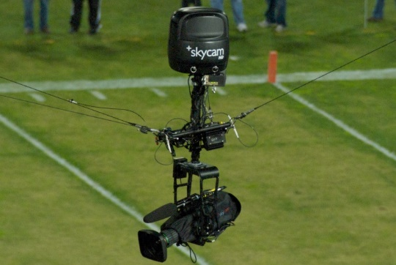
Concurrent Equilibrium Analysis Worked Example
The SkyCam shown below is supported by three cables. Assuming it has a mass of 20kg and that it is currently in equilibrium find the tension in each of the three cables supporting the SkyCam.
T_{B}
Y
T_{A}
10º
40º
15º
X
10º
T_{C}
30º
Z

Slide 18
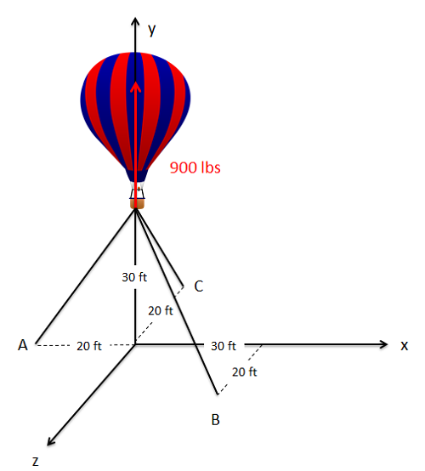
Concurrent Equilibrium Analysis Worked Example
A hot air balloon is tethered to the ground with three cables as shown below. If the balloon is pulling upwards with a net force of 900lbs, what is the tension in each of the three cables?

